Slide 1
“Count the Duplos on the table.”
Josh Villbrandt
28 Nov. 2011
CSCI 547
Keywords: ROS, PCL, Kinect

Slide 2
Algorithm Reasoning
To count Duplos, they must first be identified
Strong attributes include color and shape
Color trainer
Segments the block from background, finds mean color and standard deviation
Shape trainer
Segments the block from background and a glove (knowing glove color)
Continuously adds subsequent clouds together using VHF descriptors
On save, align block to axes using two biggest planes -> orientation
To identify
Segment from background, then by color, than by distance
Touching blocks of same color are currently return with unidentified shape

Slide 3
Implementation Details
Programs
Created “identify_duplos” package in ROS
Includes “trainer”, “identify”, “visualize”
Colors Recognized
Trained on solid red, orange, yellow, dark green, dark blue
Shapes Recognized
Trained on standard 2x2, 2x4, 2x6, 2x8 blocks
Performance
Full pose estimate runs as slow as 0.1 Hz on home computer, single thread
Quick mode operates at ~2 Hz on the same data set, single thread
bad orientation, position not at centroid, shape based on number of points

Slide 4
“Training”
remove surface
Fast Point Feature Histograms for target and template
narrow FOV
align via Sample Consensus Initial Alignment
filter out glove
transform template
statistical noise removal
set target to sum of target and transformed template

Slide 5
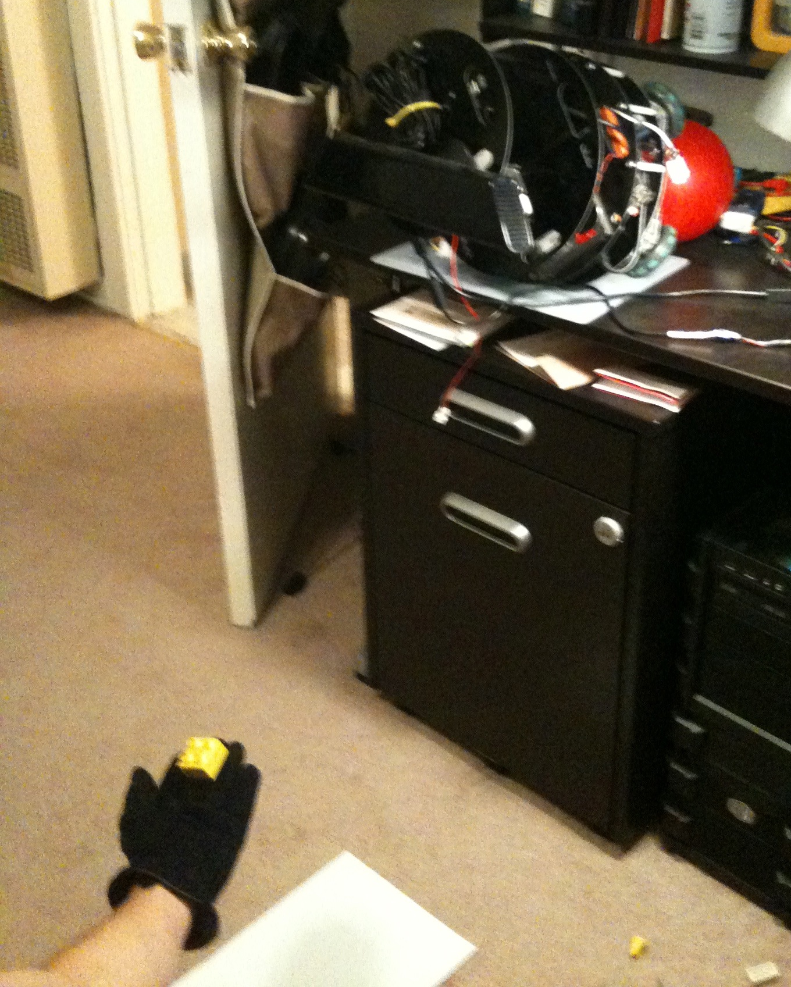
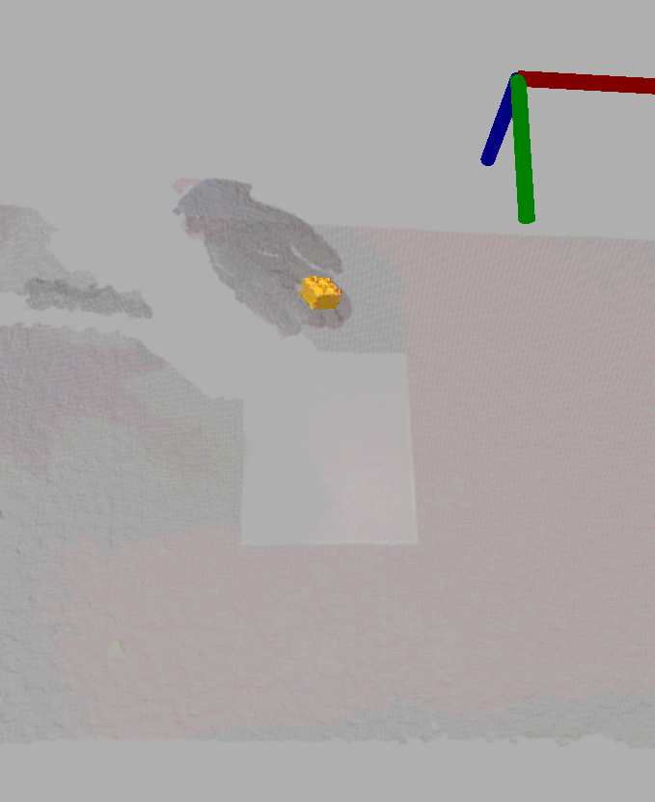
“Training” Examples
(left) Kinect viewing 2x2 Duplo
(right) isolated Duplo shown in rviz

Slide 6
“Identify”
Quick Mode
Template Align Mode
color: color with least error from average
color: color with least error from average
shape: size of particle filter (conditioned on voxel grid)
shape: result of best aligned template
position: average position of all particles
position: given as centroid of template
orientation: normal vector of largest plane in block cluster
orientation: given as normal vector of template

Slide 7
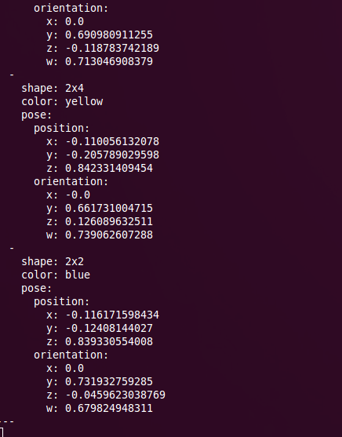
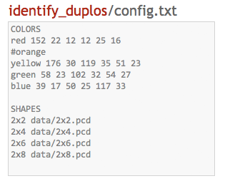
“Identify” Examples
(left) config file, built from training
(right) ROS message, shown w/ rostopic

Slide 8
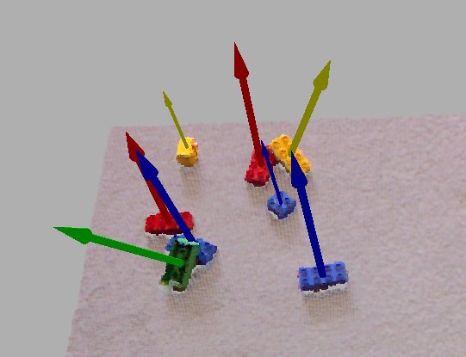
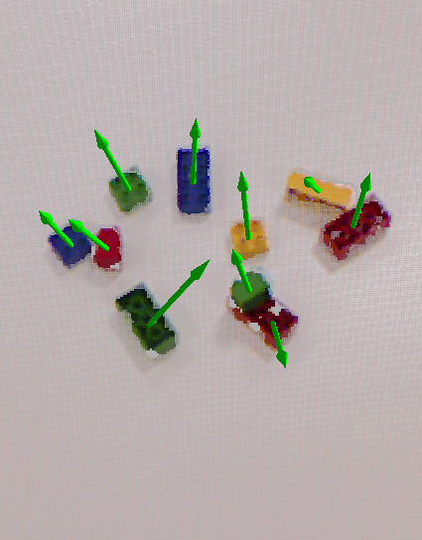
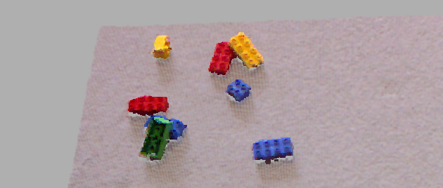
“Visualize” Examples
(left) Kinect at home (quick mode)
(right) group2_3.pcd/PR2 (quick mode)

Slide 9
Steps for Improvement, Further Development
Better shape building / pose estimation (FPFH alone limited to three faces)
Possibly limit rotation during SAC alignment search for continuous build
HSV color to remove dependence on brightness
Drop-in OpenMP replacements for PCL functions
Try separating touching blocks of same color by applying and removing known shapes
Internal Bayes filter could handle occlusions ^_^
From robot arm
So many blocks, one gets covered
Rotation

